Slide 1
PROFESSIONAL ISSUES IN.
INFORMATION TECHNOLOGY.
#UpgradingYourWorld as an ICT Professional
Dr. Jason Sargent

Slide 2

This session’s roadmap
What we will be covering.
Genesis of the UpgradeYourWorld hashtag
Ways about upgrading yourself, your team, your organisation, your community and your society
Professional Development, Mentoring & Coaching
Examples of Technology Proficios
How to start to begin the tech proficio mission
Good reasons to work with Public Interest Technology and go about upgrading your world
Considerations when heading down the path of upgrading your world especially in the humanitarian technology domain.

Slide 3
This session’s objectives
Objectives of this session.
Understand the genesis of the UpgradeYourWorld hashtag
THINK & REFLECT upon implied obligations as a current/future ICT Professional
Become aware of Technology Proficios
Identify areas for further exploration in your own time
Be more knowledgeable at the end of the session

Slide 4
This session’s ULO’s
2. Evaluate the role of standards, codes of conduct and legislative/regulatory obligations on the level of professionalism of the ICT industry
3. Review the roles and responsibilities of ICT professionals in organisations and society from a range of perspectives such as work-life balance, mentoring and life-long learning
What you need to do with this recorded presentation.
Watch, reflect and take your own notes. Bring any queries you may have on the concepts ready for the weekly LIVE catchup classes.
How long will this task take.
This task will take approx. 60 minutes to complete.

Slide 5
What is Public Interest Technology?.
You may have been hearing the term ‘Public Interest Technology’ recently.
The deployment of technological expertise in service of the common good, often with a focus on under-resourced communities and needs (Cornell University).
The domain considers the importance of:
socio-technical change
responsible innovation
public values
accountability
oversight
corporate responsibility and
other key concepts when considering technologies working for the public interest.
PIT adopts best practices in human-centered design, product development, process re-engineering, and data science to solve public problems in an inclusive, iterative manner—continuously learning, improving, and aiming to deliver better outcomes to the public (New America 2021).

Slide 6
Let’s ask a PIT Guru: According to Bruce Schneier
I think of public-interest technologists as people who combine their technological expertise with a public-interest focus, either by working on tech policy, working on a tech project with a public benefit, or working as a more traditional technologist for an organization with a public-interest focus.
Public-interest technology isn’t one thing; it’s many things.
And not everyone likes the term. Maybe it’s not the most accurate term for what different people do, but it’s the best umbrella term that covers everyone.
Notes:
https://public-interest-tech.com/

Slide 7

Genesis of the UpgradeYourWorld Hashtag
#UPGRADEYOURWORLD
2015 Microsoft release of the Windows 10 O/S
$10 Million to 110 organisations to go an upgrade their worlds
Why – Upgrade Your World resulted from Microsoft’s position that technology can be a strong force to drive impact.
This aligns closely with Public Interest technology (PIT)

Slide 8

What is our world?
Our World is US
How would you Upgrade YOU?
How would you Upgrade your TEAM?
How would you Upgrade your ORGANISATION?
How would you Upgrade your COMMUNITY?
How would you Upgrade your SOCIETY?
We’ve completed the circle. We have #UpgradedOurWorld

Slide 9

How would you Upgrade YOU?

Slide 10
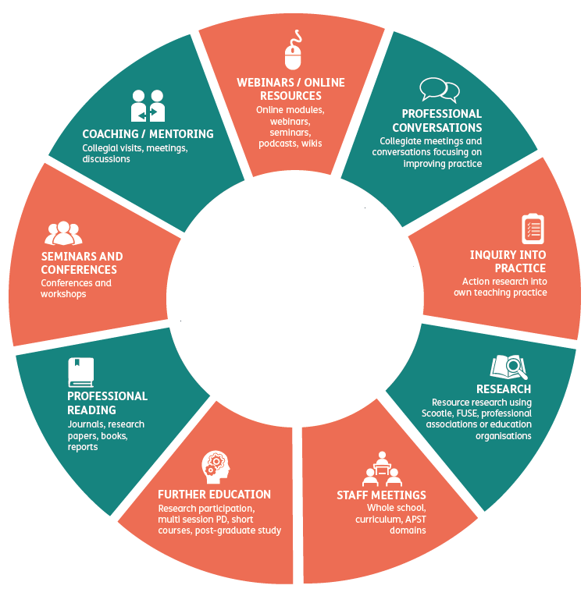
Professional Development.
You’re doing it now.
Continuing Professional Development (CPD
Formal CPD = short courses, work-related courses and attendance at conferences.
Informal CPD = learning new skills on the job and being mentored by somebody with more experience in your field.

Slide 11
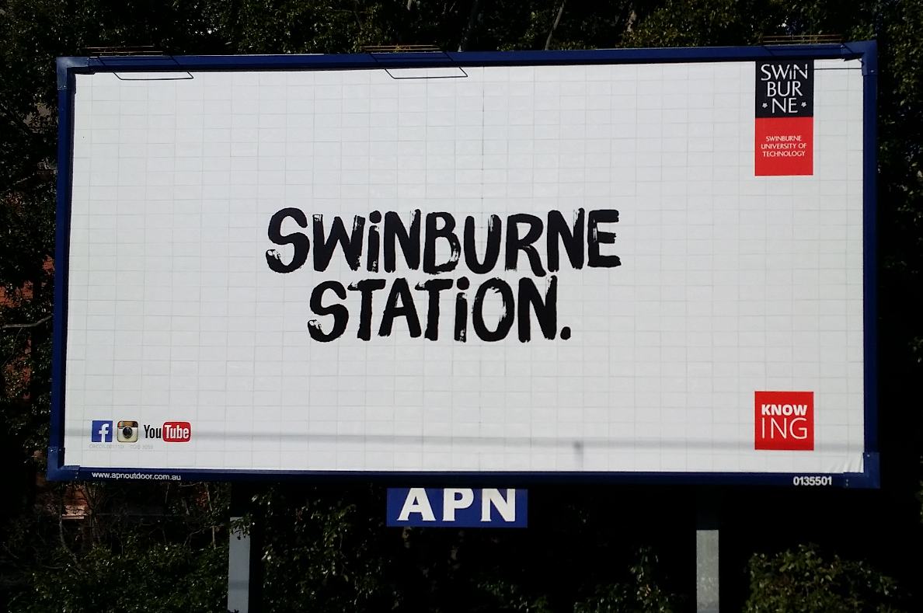

Slide 12


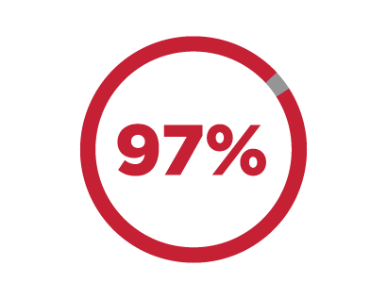
Let’s break the context down
How can you upgrade yourself?
How can you upgrade your team, your organisation, your community, your society?
You are receiving a world class, accredited higher education. Swinburne is in the top 3% of universities worldwide / 321 QS Rankings 2021
The ‘Birth lottery’
Do YOU/ should YOU have an obligation to ‘give back’ or to ‘pay it forward’ for your opportunities, access to technology, connections/social capital & skill development?

Slide 13
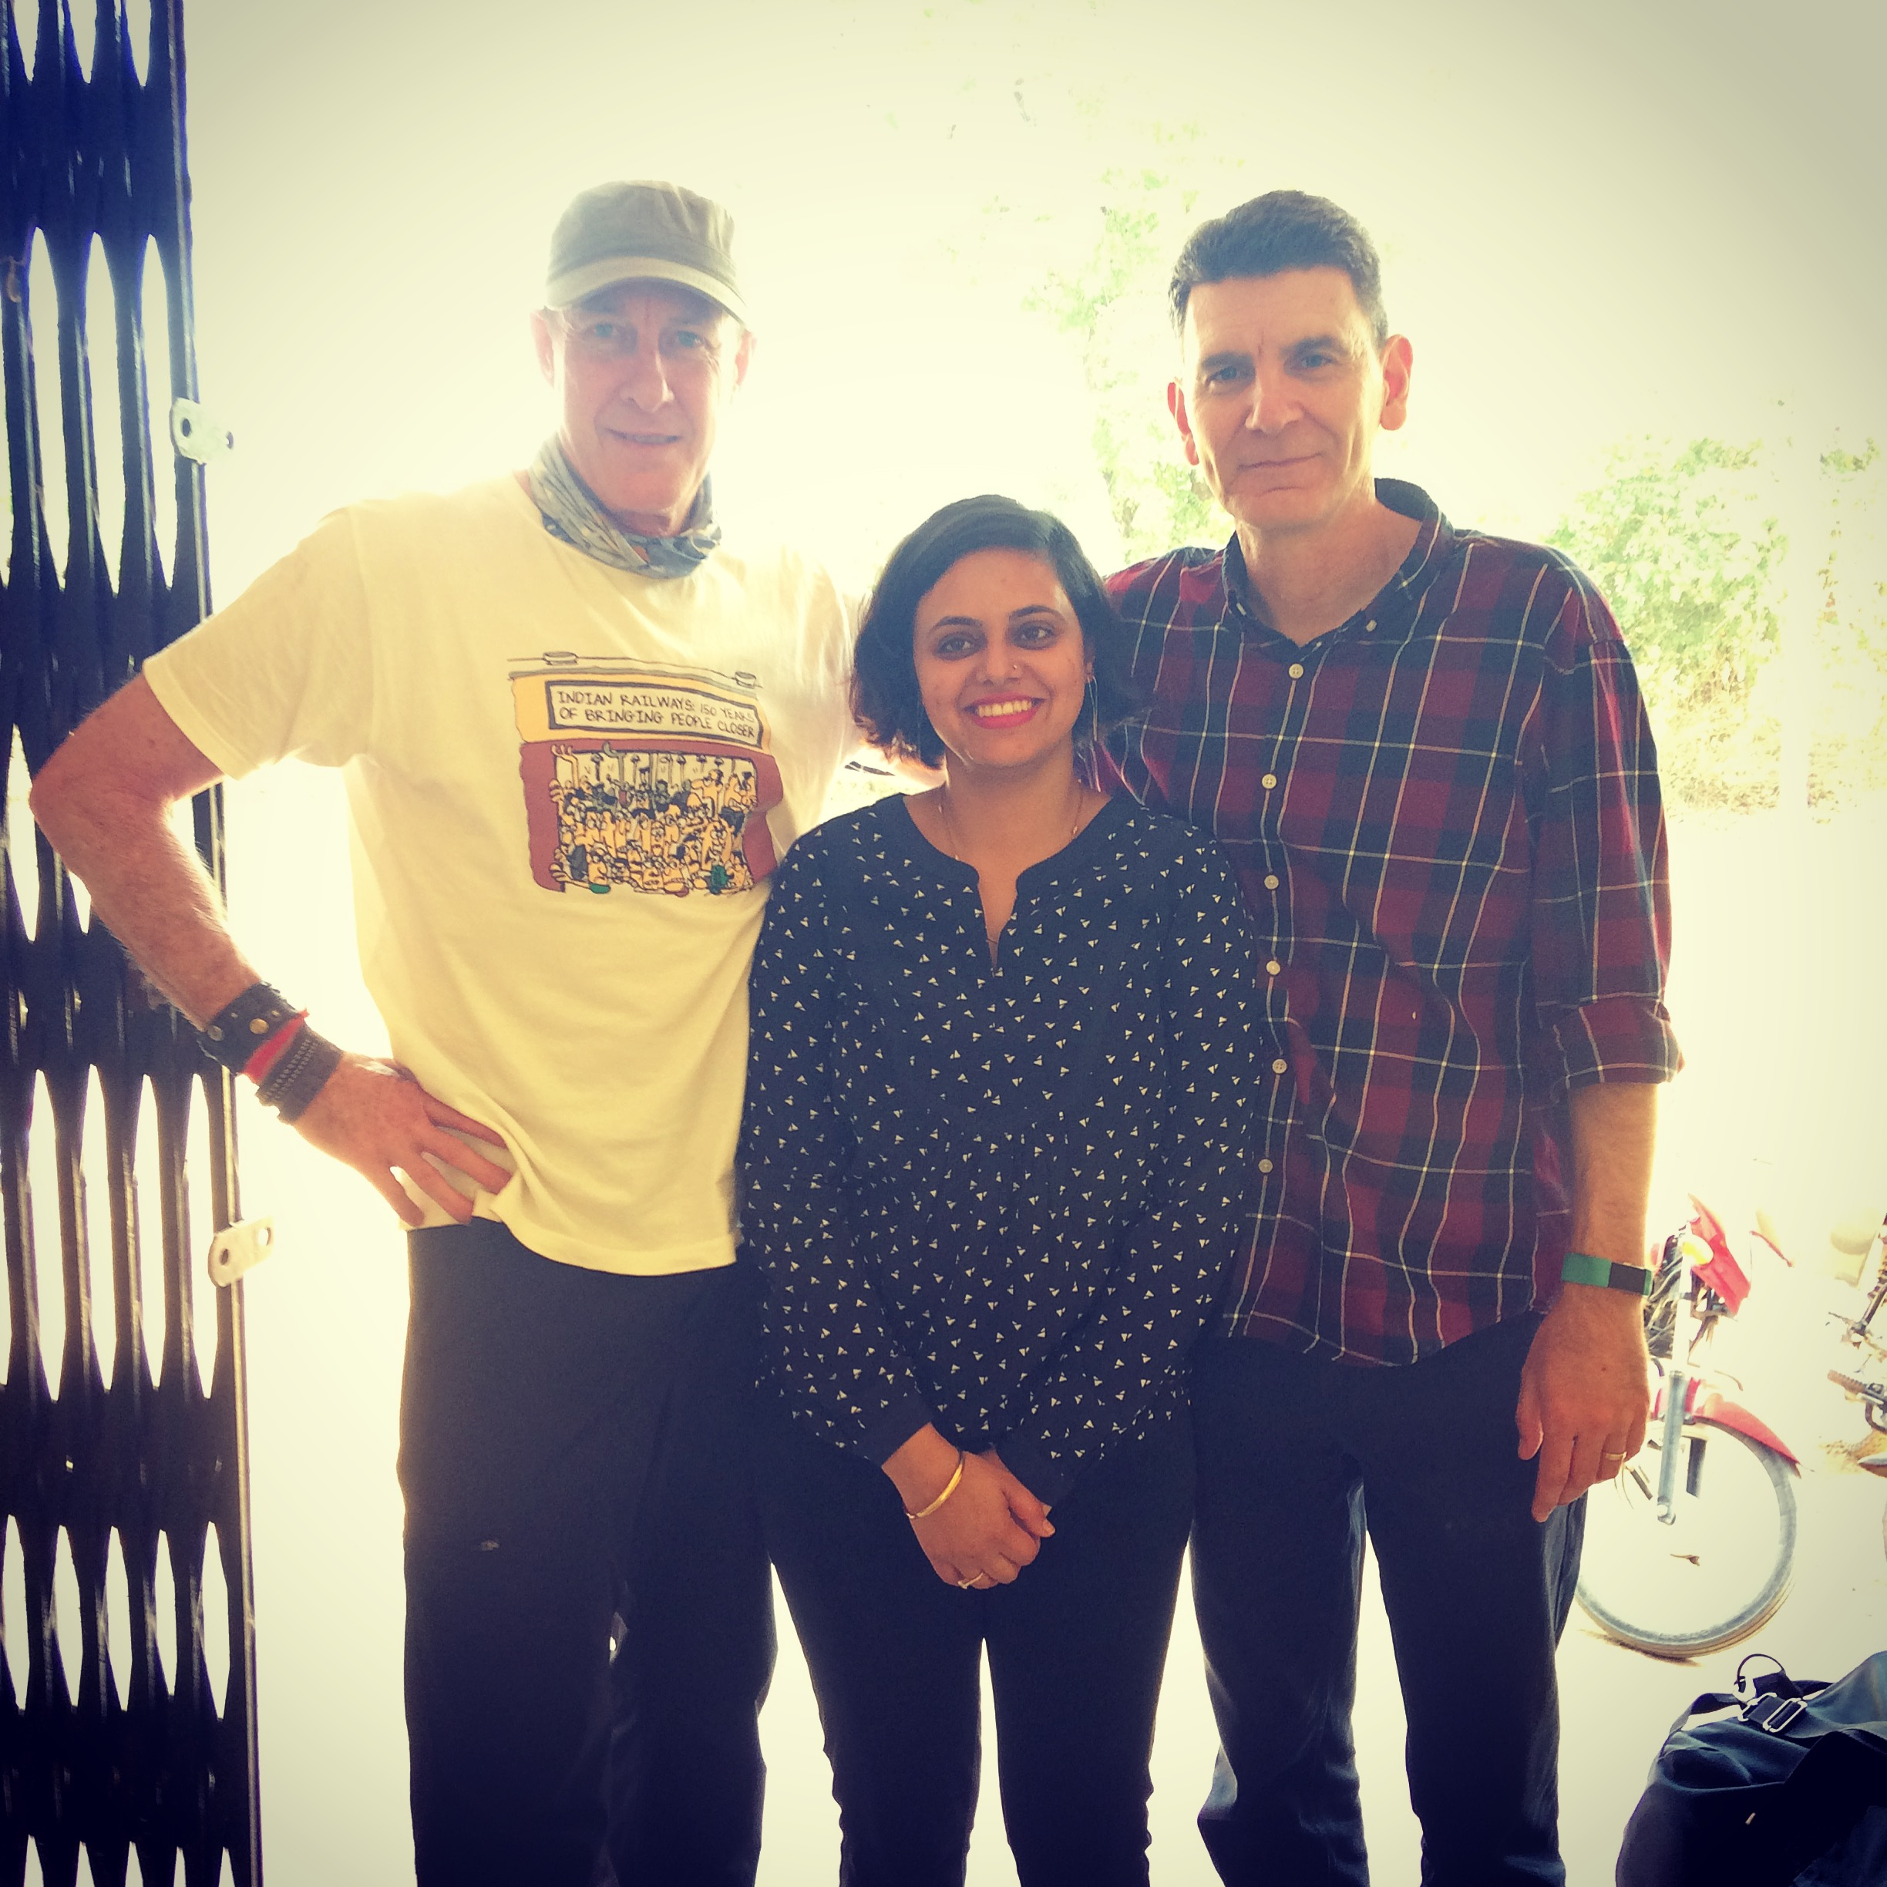
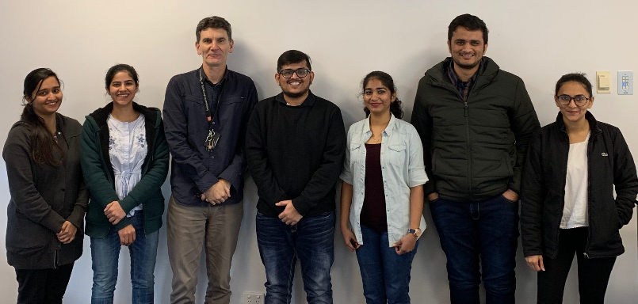
If you feel the answer = YES, how would you give back or pay it forward as an ICT professional?
Mentoring
Coaching
Being a ‘sounding board’

Slide 14
Mentoring & Coaching
Mentoring
Greek mythology: Ulysses trusted his son Telemachus to the care and direction of his old friend, Mentor, before setting out to fight in the Trojan War.
The mentor is not always older. Though generally wiser to ways of the world (and the organisational processes & culture).
Structured or informal.
Informal is the most common -- taking someone under their wing.
Structured mentoring involves a relationship which is established between a mentee and mentor for a pre-determined period.

Slide 15
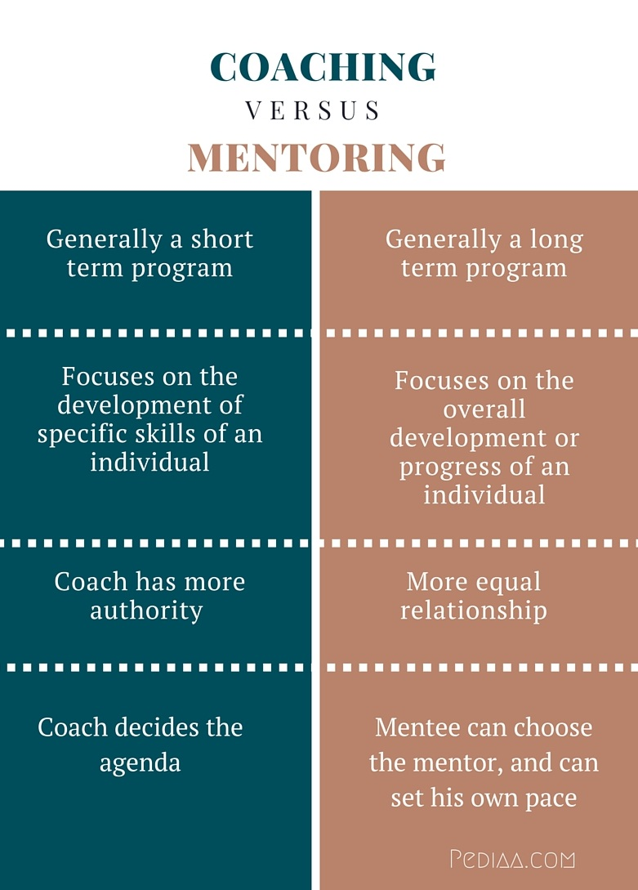
Mentoring & Coaching.
Coaching
Partnering with clients in a thought-provoking and creative process that inspires them to maximise their personal and professional potential.
The role of the manager, in short, is becoming that of a coach.
Increasingly, coaching is becoming integral to the fabric of a learning culture—a skill that good managers at all levels need to develop and deploy.

Slide 16
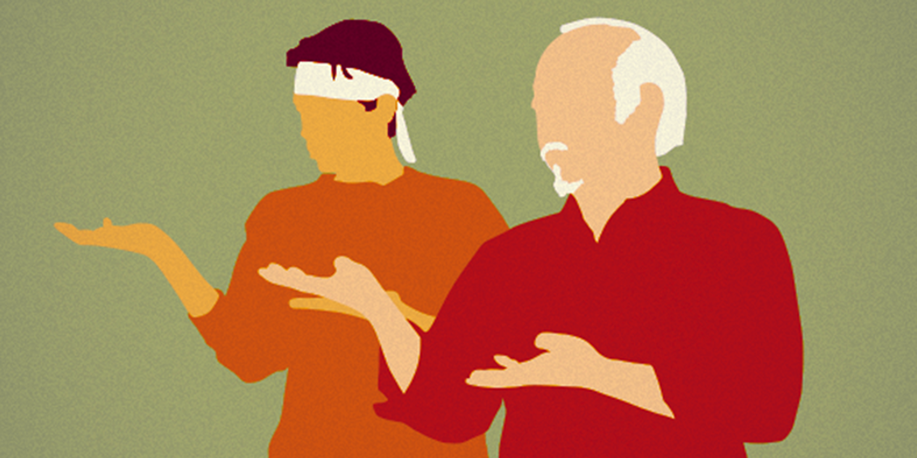
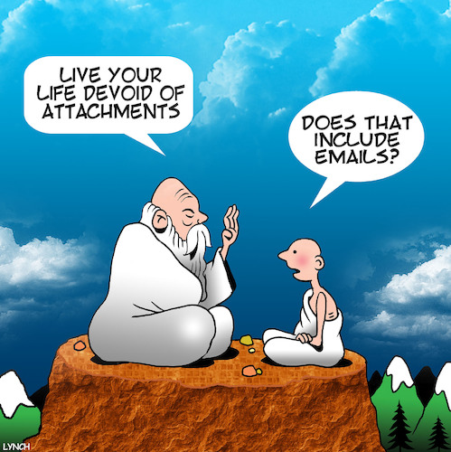

Mentoring…Hmmm…Coaching…
A relationship between two people with the goal of professional and personal development.
Beware of Mentorship Malpractice’
(Chopra, Edelson & Saint 2016)
Notes:
https://jamanetwork.com/journals/jama/article-abstract/2512789

Slide 17

Trust.
Fukuyama (1995) defines trust as “the expectation that arises within a community of regular, honest, and cooperative behavior, based on commonly shared norms, on the part of other members of that community” (p. 26).
The need for trust stems from the lack of detailed knowledge about others’ abilities and motivation to act as promised (Deutsch, 1958).
The formalisation of a trusting relationship therefore occurs where A trusts B to do X (Kohn, 2008).
Issac Stern said, "Music happens between the notes" and the same is true for trust. Trust happens between the meetings.

Slide 18
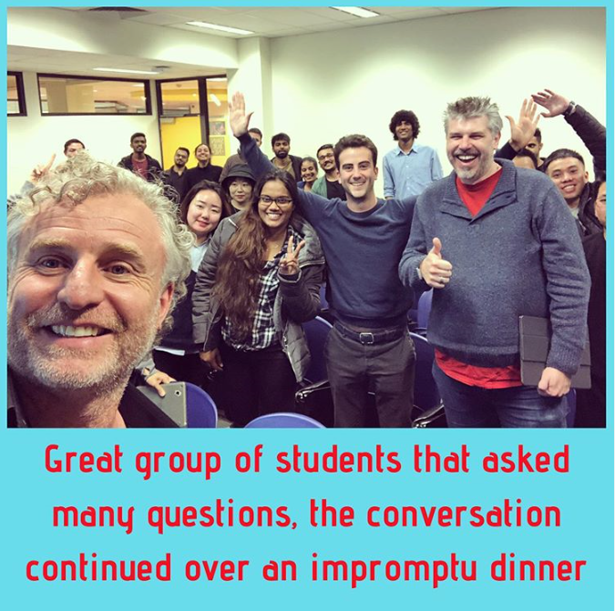
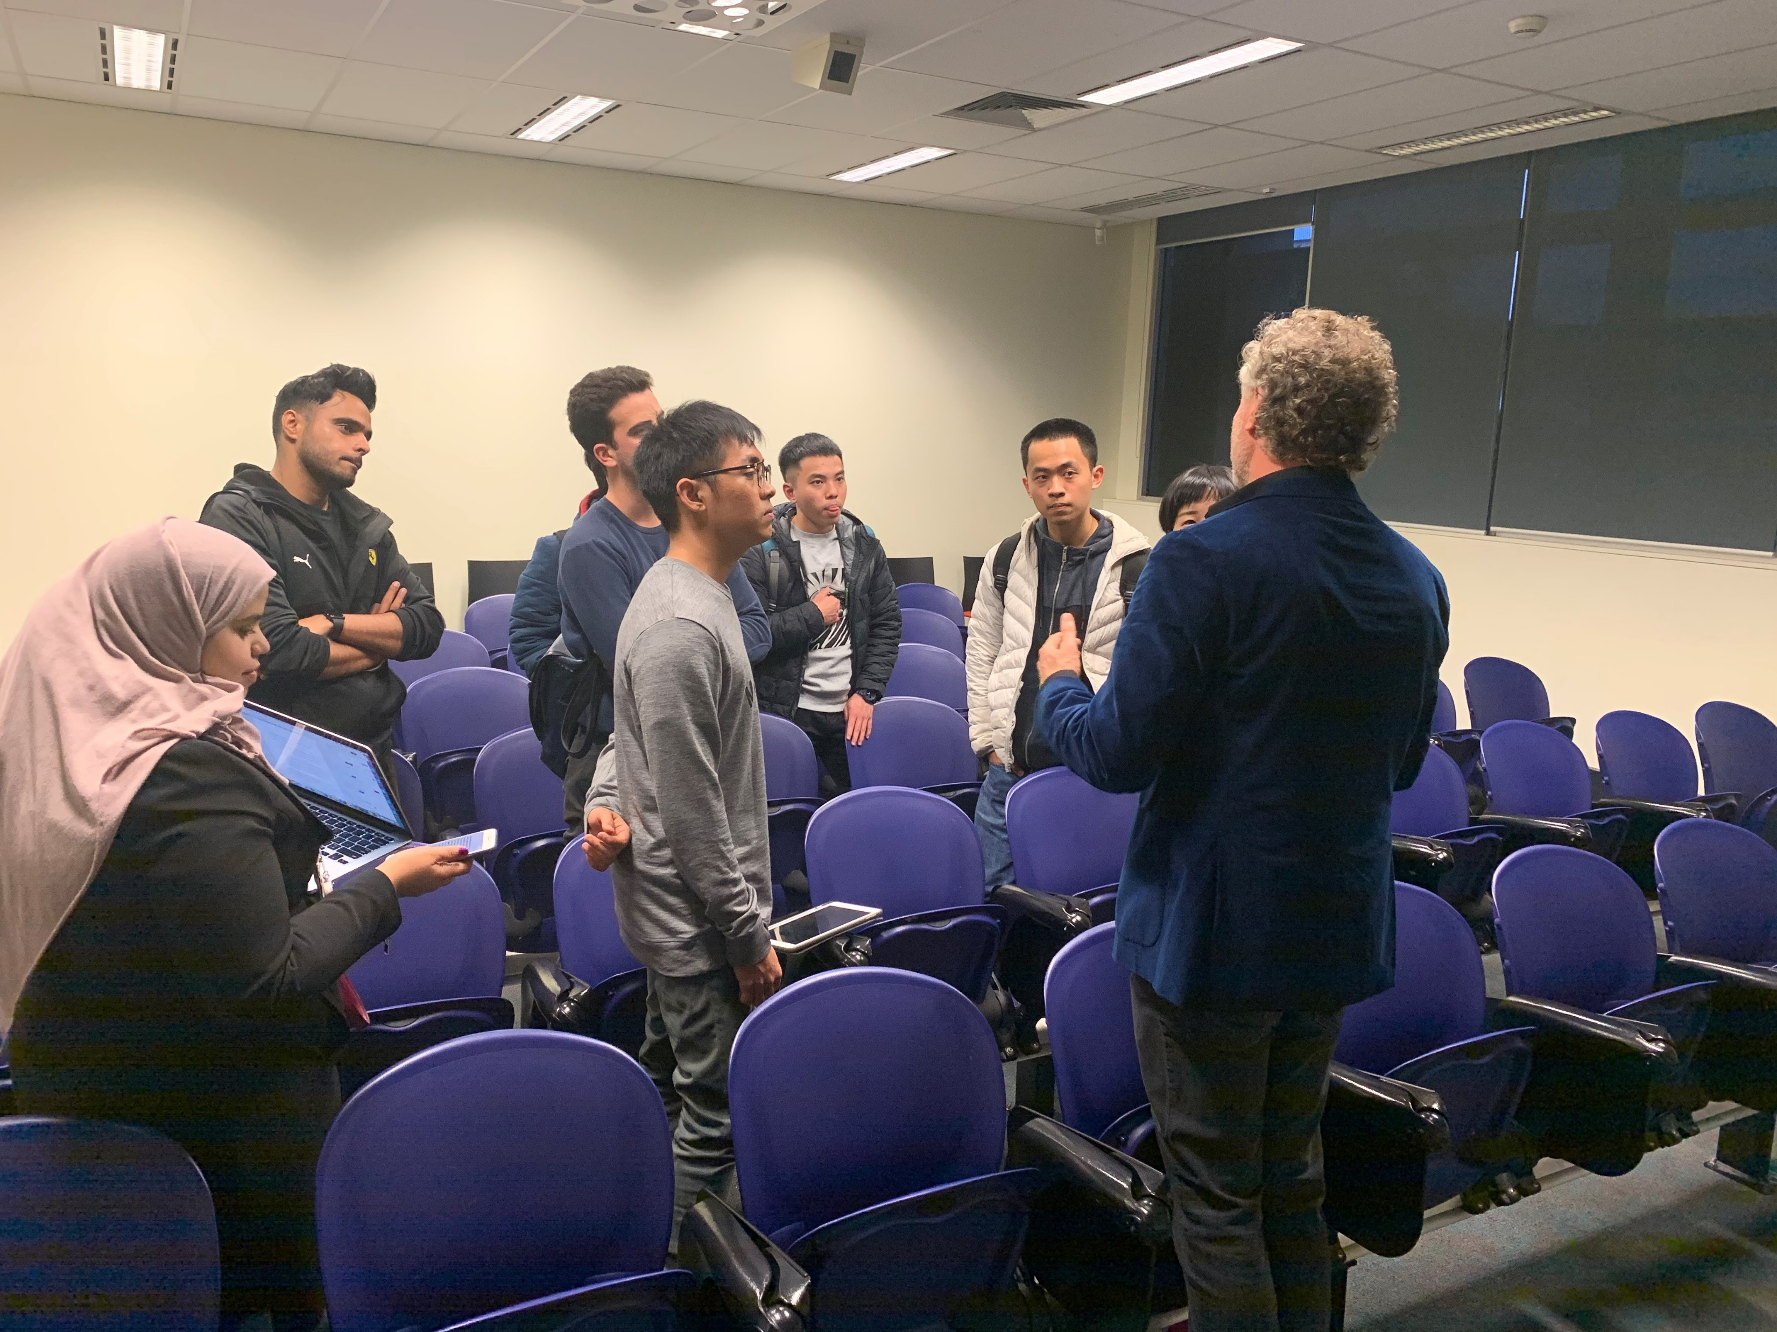
Pro-bono.
Adj. denoting work undertaken without charge
David Banger, CHANGELead

Slide 19
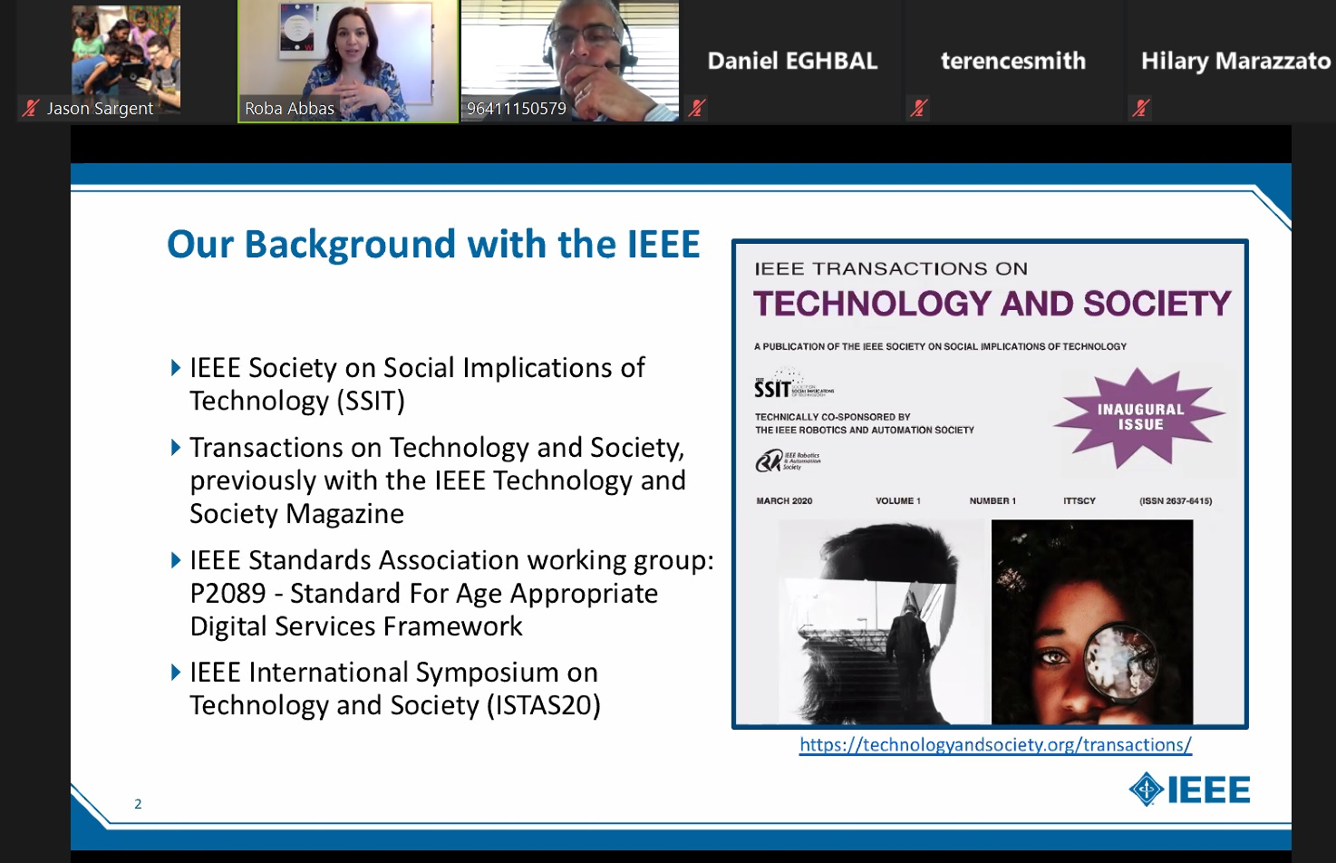
Pro-bono

Slide 20
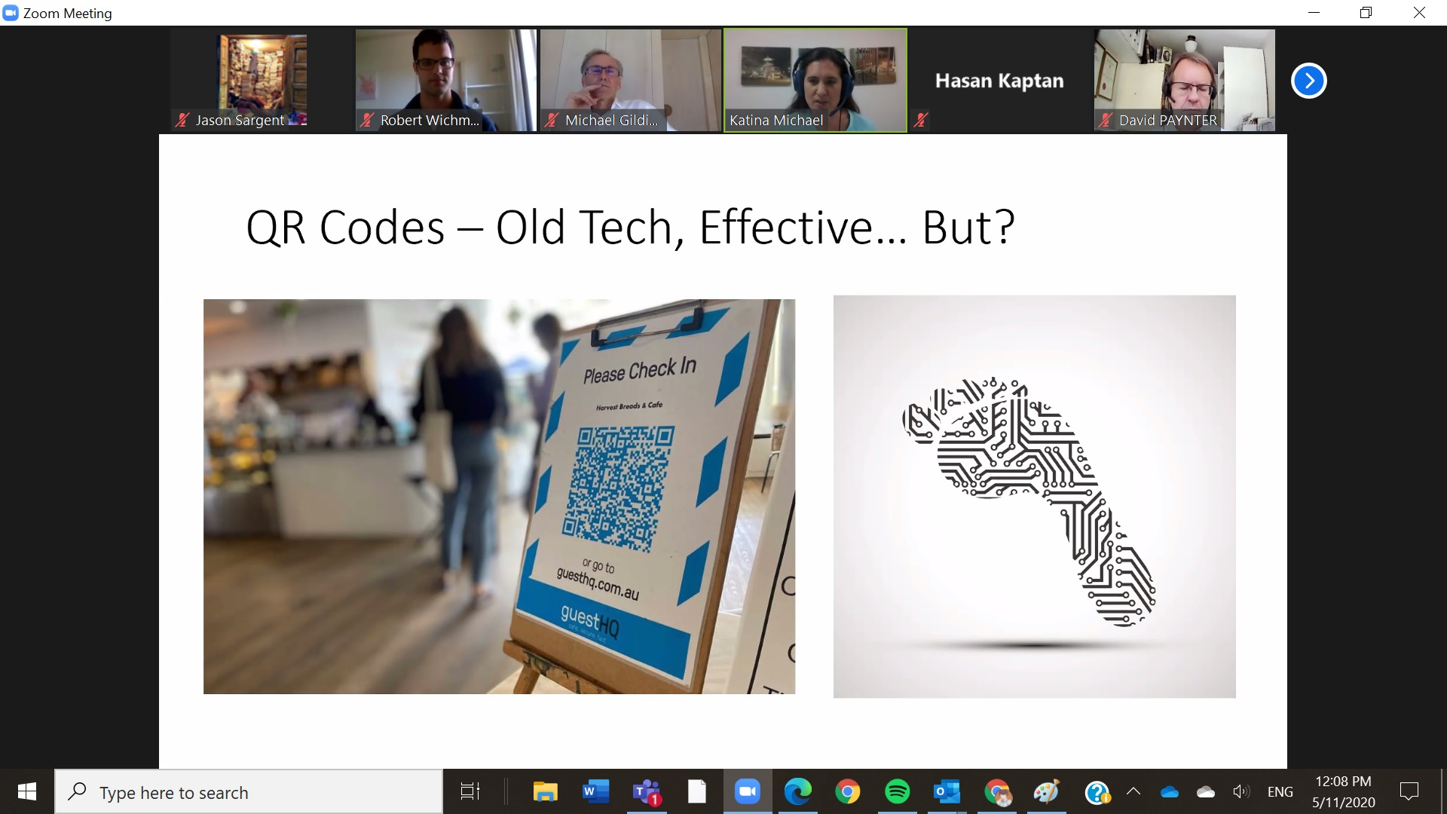

Slide 21
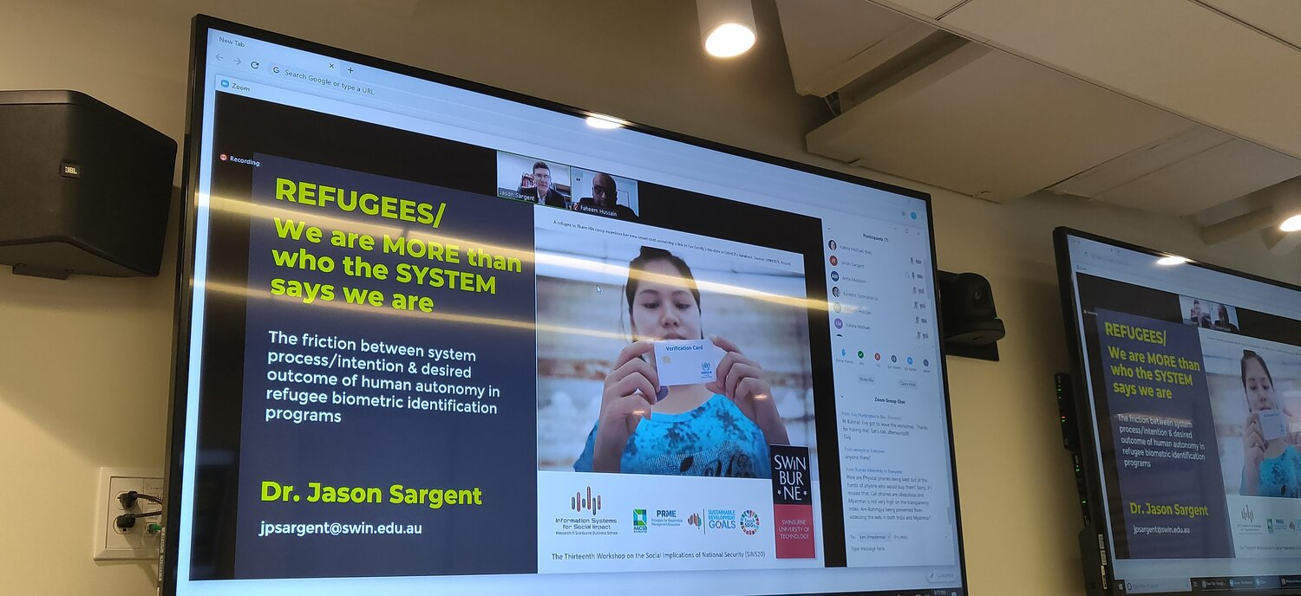
Refugee ID / Multi-modal Biometrics ID
EPS/DFS / Digital Aid Frameworks
Social Implications of National Security (SINS20)
Washington, DC

Slide 22
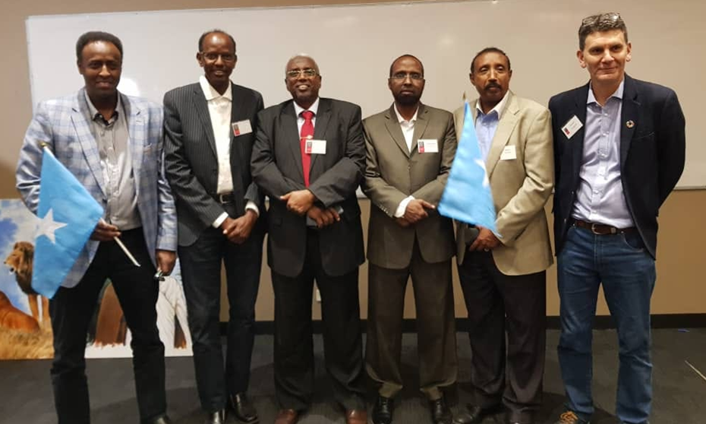




Election Digital ID / Education Passports / Digital Literacy / World’s Largest Lesson / Data mapping / IoT in Agriculture / Somali Cultural Archives
2nd Annual Swinburne-Somali Research Symposium

Slide 23
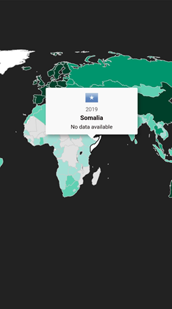

#UpgradeYourWorld
Networked Readiness Index (/139)
N/A
Human Development Index (/189)
N/A
“We can collect data if we are able to roam around Mogadishu safely and without the tribe/clan card or private armed militias. The only other solution is to move the capital and start a new history. It just can't happen in the current Moga we see”. Hibaq Nur, LinkedIn

Slide 24

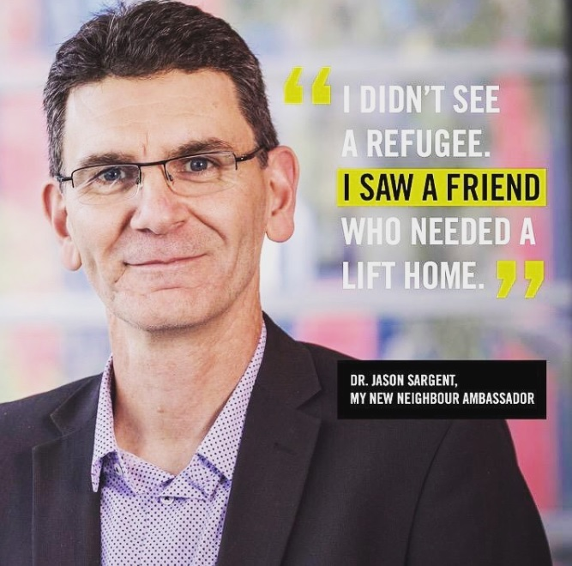

Slide 25
Take inspiration from Technology Prōficiōs
Infoxchange
Benetech
Be Collective
Ecosia
Vodafone DreamLab
That Dragon, Cancer
“When I was a child, I wanted to be...”
Global Pulse

Slide 26
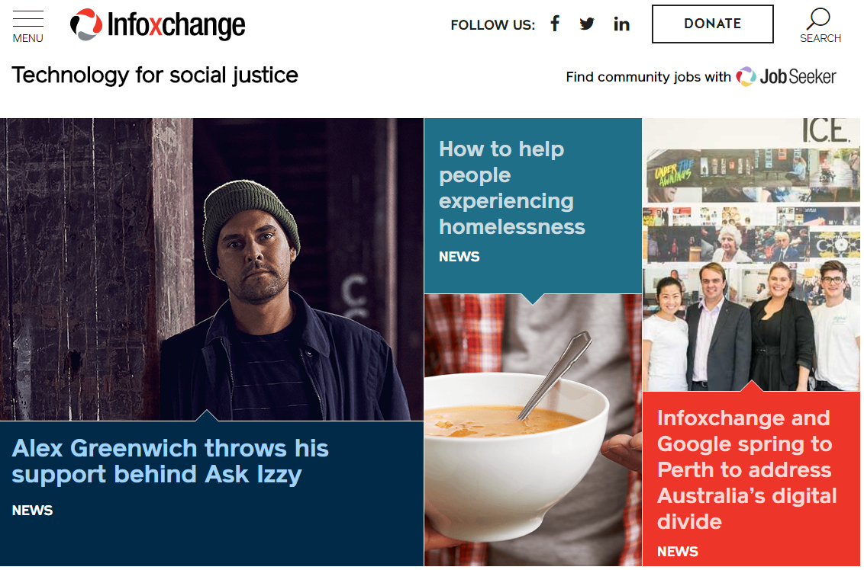


Infoxchange

Slide 27
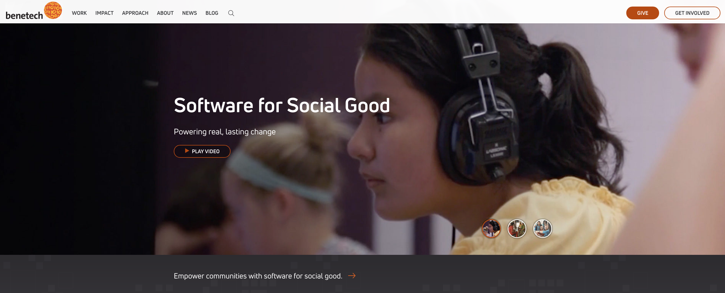


Benetech / Technology serving humanity

Slide 28
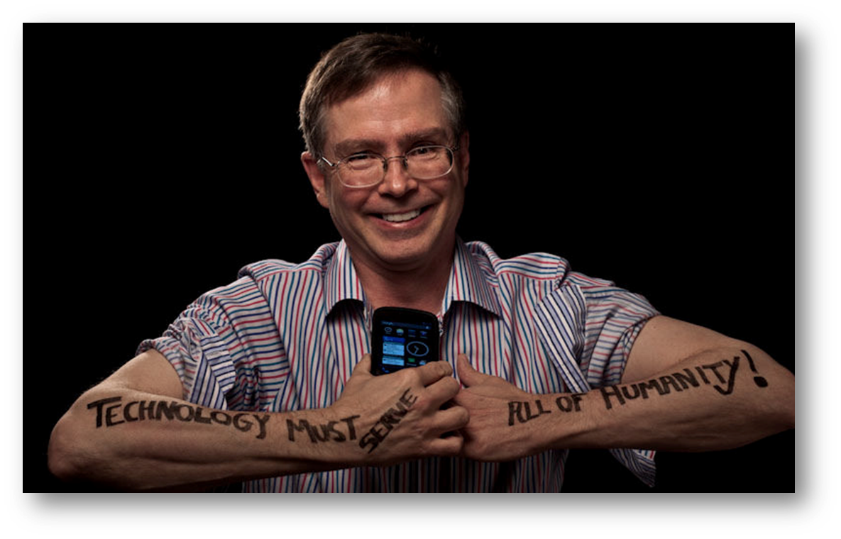
Jim Fruchterman / Benetech
Technology must serve all of humanity

Slide 29
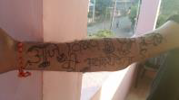
Your Convenor’s homage to Jim
There is an acute shortness of love in the world

Slide 30
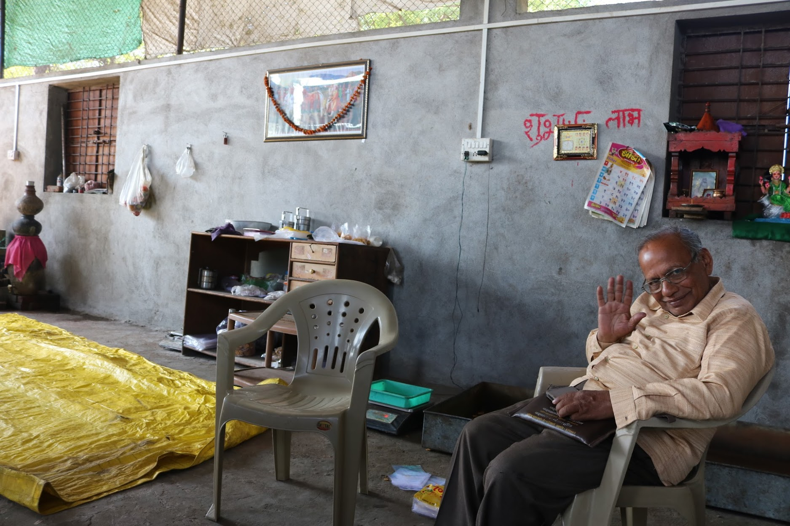
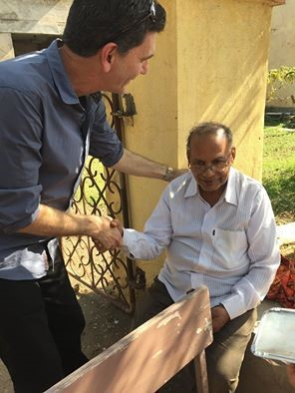
Zambare is my Guru

Slide 31
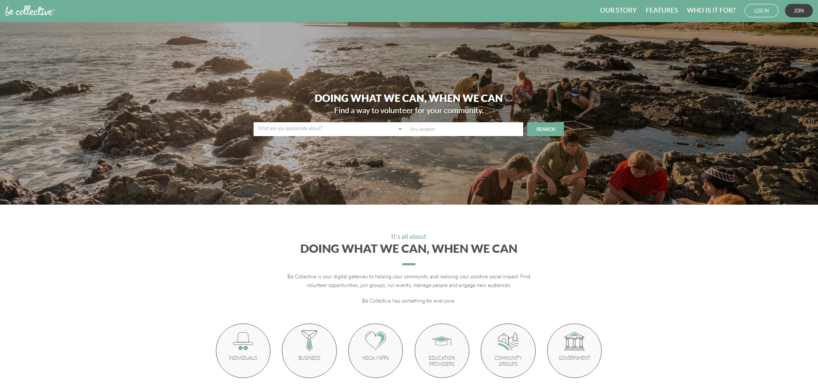
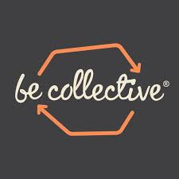
Be Collective

Slide 32
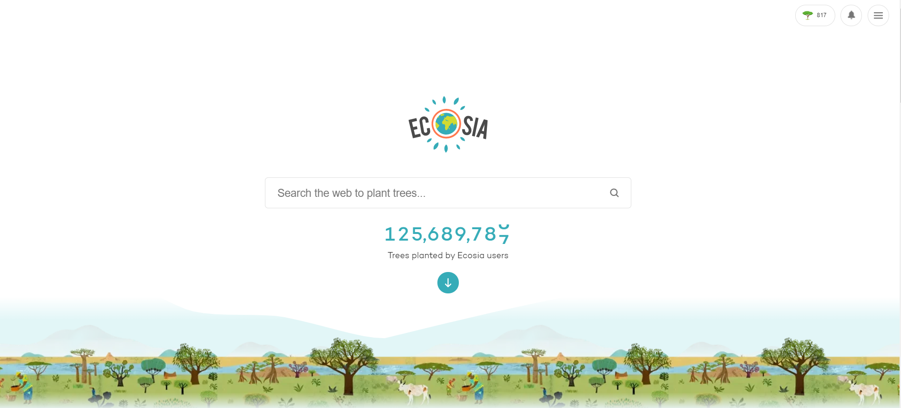
Ecosia

Slide 33
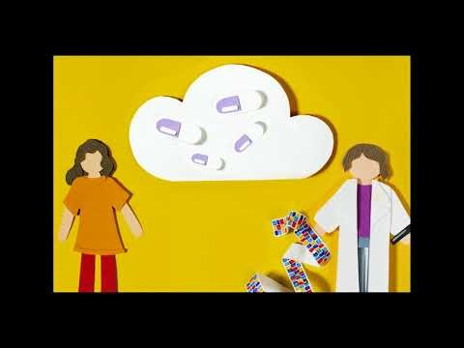
Dreamlab / Solving Cancer, Quicker

Slide 34
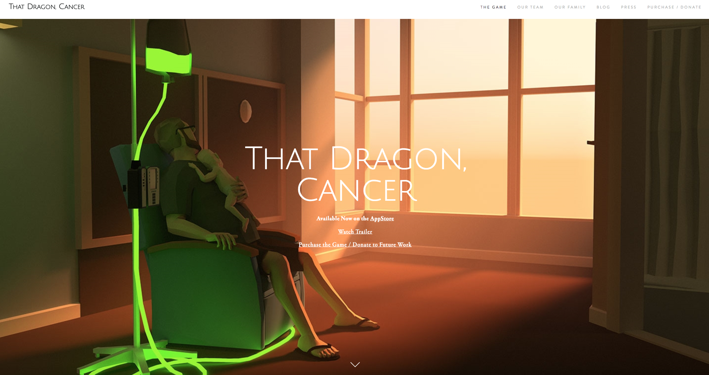
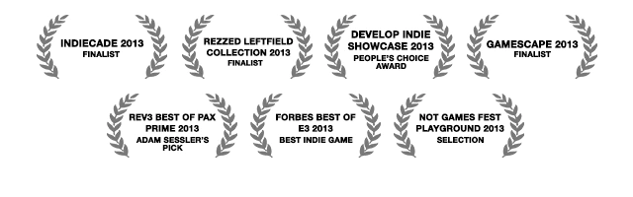
That Dragon, Cancer
http://www.thatdragoncancer.com/

Slide 35
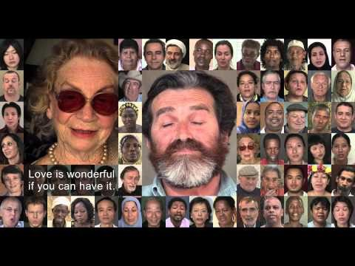
7 Billion Others / The impactful power of multimedia

Slide 36


UN’s Global Pulse

Slide 37


Slide 38

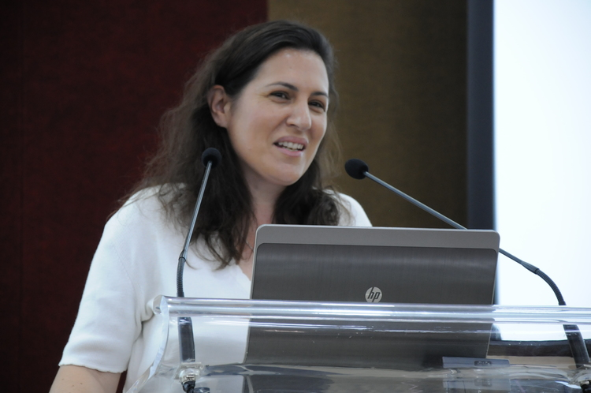

Stand on the shoulders of Giants / Find your BFG!
Professor Katina Michael
Center Director of Engineering, Policy and Society. School for the Future of Innovation in Society http://www.katinamichael.com/

Slide 39
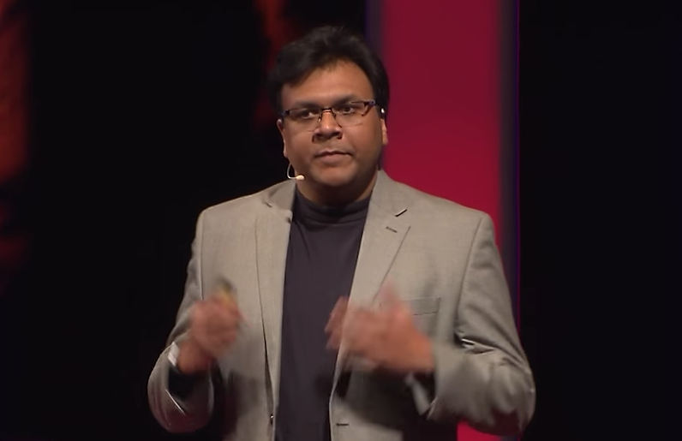
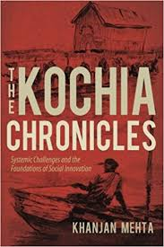
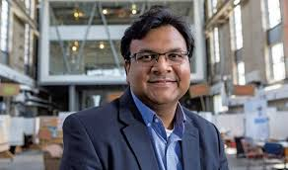
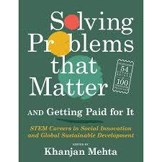



Feed on & drink up the knowledge of GIANTS
Khanjan Mehta
https://youtu.be/2haT4TgjR7o?t=13s

Slide 40
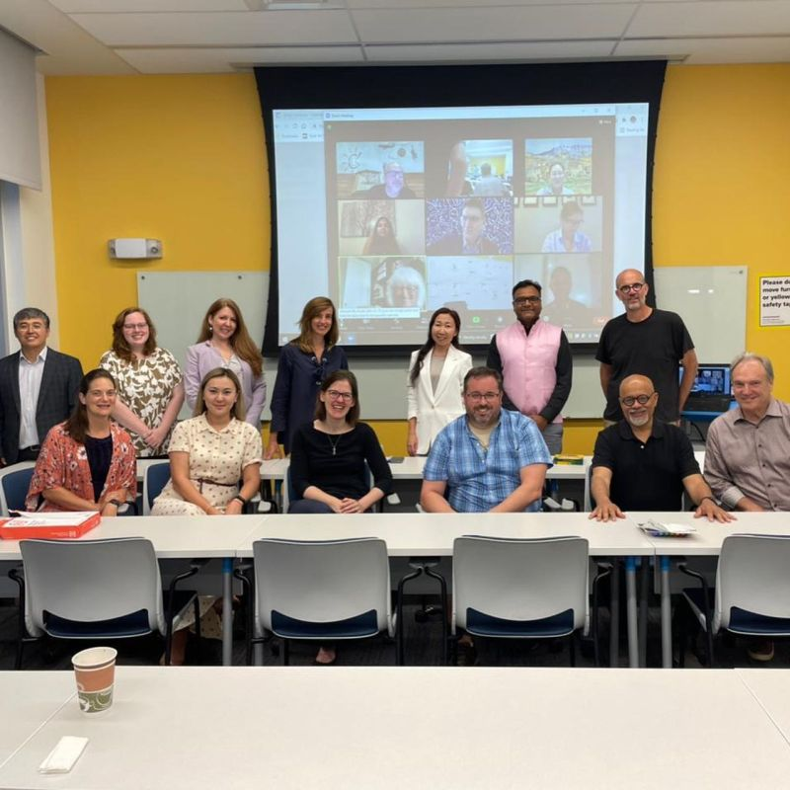
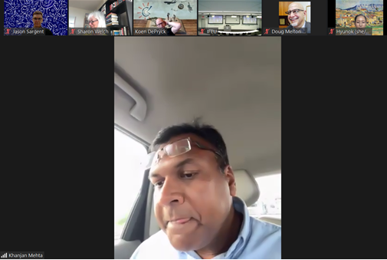
Feed on & drink up the knowledge of GIANTS
Khanjan Mehta

Slide 41

Social Impact takes a Planet.
Khanjan Mehta

Slide 42
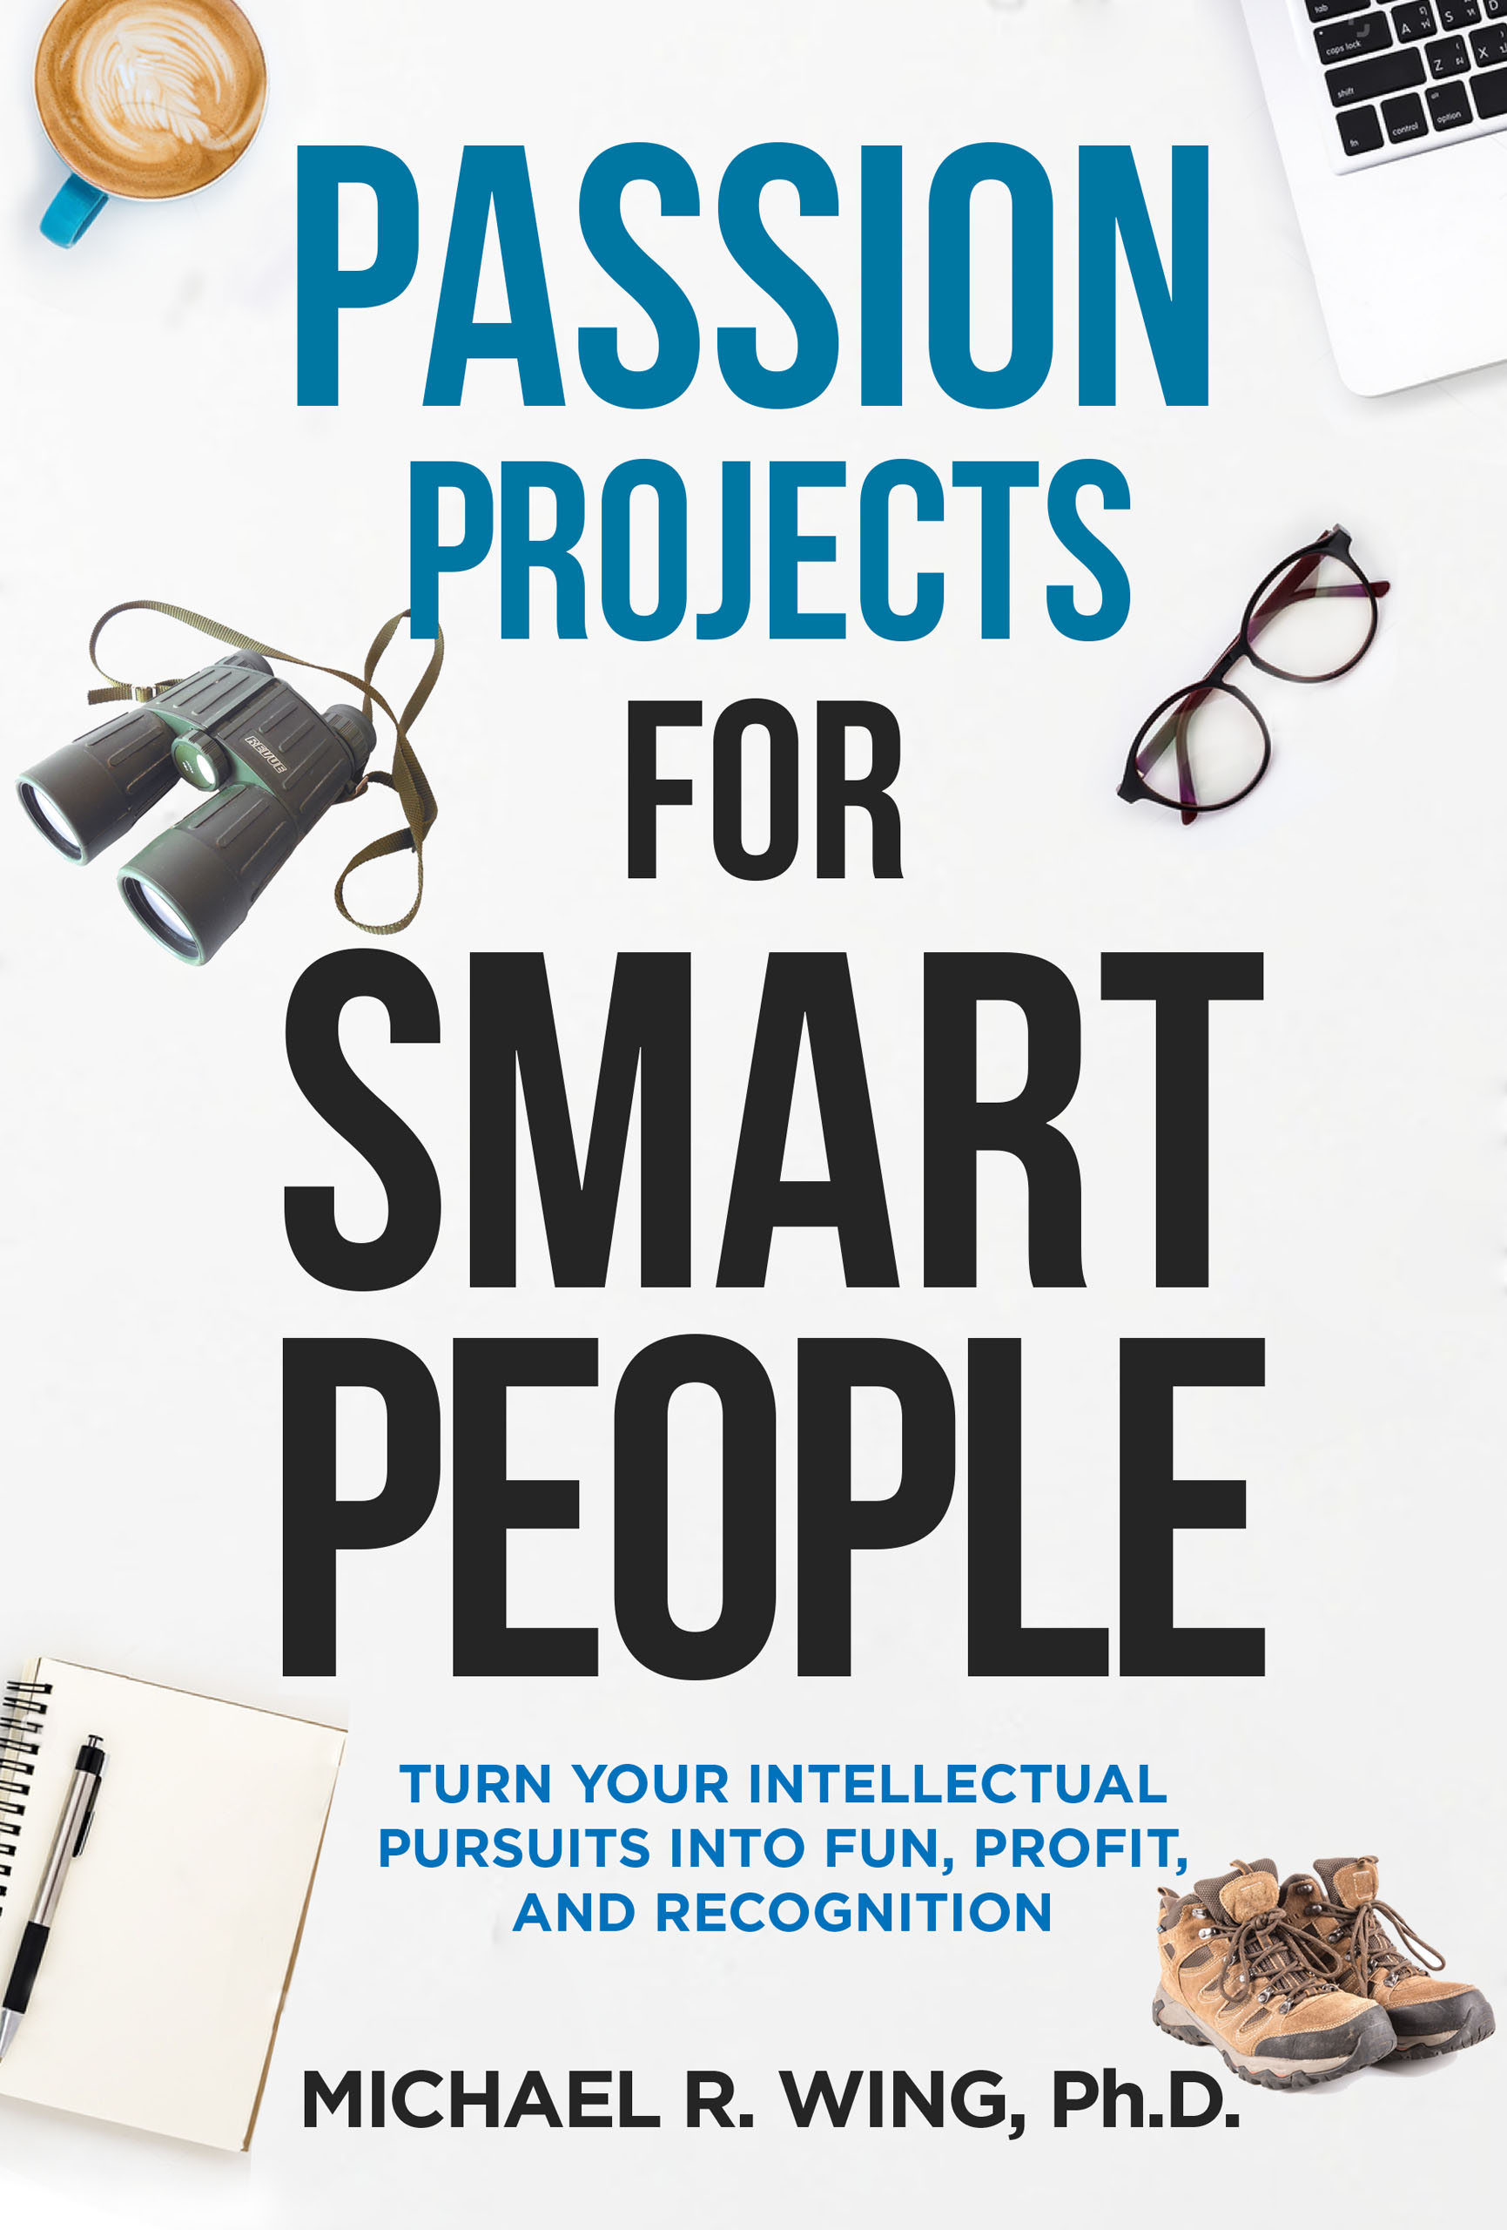

Passion Projects
Why Tech Companies Can Benefit From Passion Projects
Samantha Radocchia, FORBES 2018
Taking a different way walking to work…that’s what your side projects are—little side streets that can lead you to new ideas.
Giving your team an outlet—even one that’s tangentially related to the work they’re doing—is a good way to foster individual growth and keep people from burning out.
Ideas will compound into something bigger and better for your team.

Slide 43

.If you received
1 year’s salary and were told
“Go.Do.Change!”
.What would you do?.

Slide 44


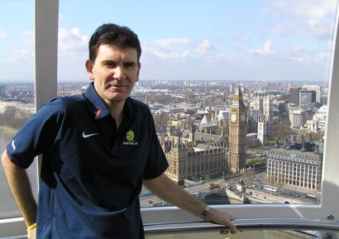

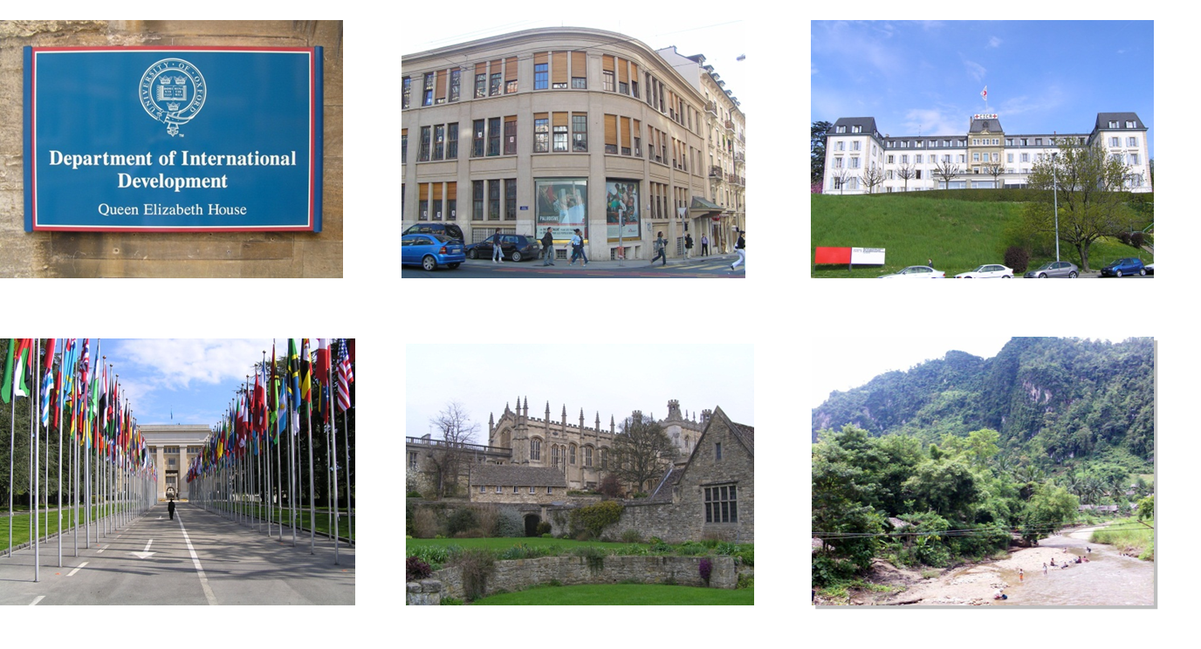
Why #UpgradingYourWorld is worthwhile.
What other ICT, IS, Info Mgmt topic includes:
Cutting-Edge Technology Applications
Intrinsic E-Business Processes
Human Rights, Equity, Ethics, Morals
Politics, Current Affairs, Regulations, Mandates
Social Impact
The Beautiful people
Philosophy, Sociology, Spirituality, Theology
Continual applied & research need (Natural disasters and Man’s inhumanity to Man)

Slide 45
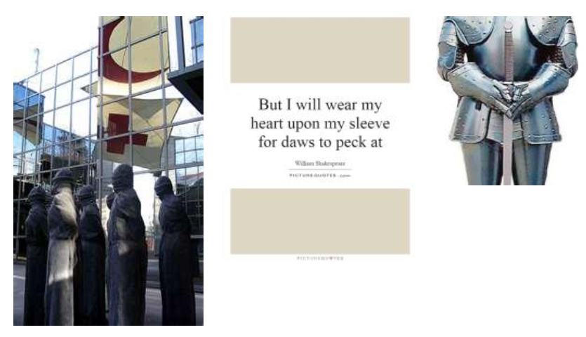
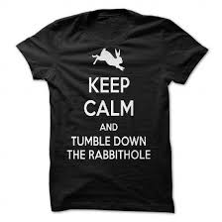
Some considerations on why #UpgradingYourWorld can can be ‘difficult’.
You will go down the rabbit hole!
To enter into a situation or begin a process or journey that is particularly strange, problematic, difficult, complex, or chaotic, especially one that becomes increasingly so as it develops or unfolds.
(An allusion to Alice's Adventures in Wonderland by Lewis Carroll.)

Slide 46
Some considerations on why #UpgradingYourWorld can can be ‘difficult’.
Unpredictable physical and socio-political environment
Desperate people can do desperate things
Beware of Friedrich Nietzsche’s Monsters
"Battle not with monsters lest ye become a monster; and if you gaze into the abyss the abyss gazes into you”.
Kübler-Ross model (aka the 5 stages of grief)
Denial, Anger, Bargaining, Depression, Acceptance
(some NGOs) … if you do not ask, you will NOT be told
Pro Bono expectation

Slide 47
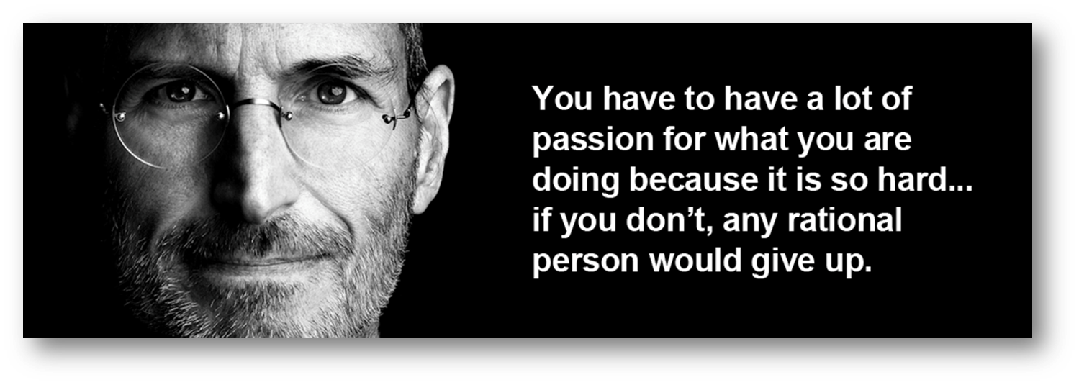
Passion often over-rides the downside

Slide 48

What are you waiting for?
Arthur Brooks, 2019
https://www.theatlantic.com/magazine/archive/2019/07/work-peak-professional-decline/590650/
Notes:
https://www.theatlantic.com/magazine/archive/2019/07/work-peak-professional-decline/590650/

Slide 49
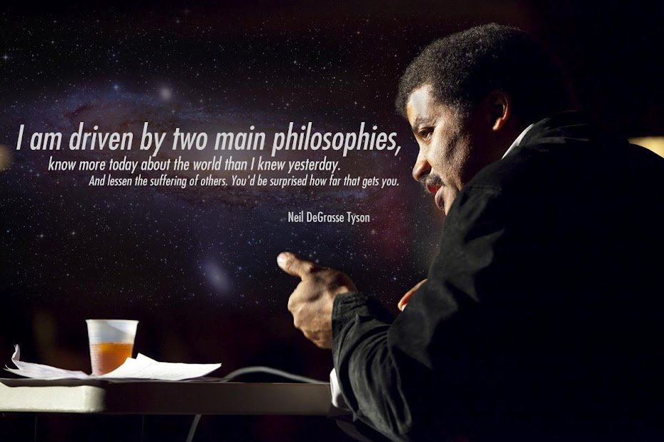
https://www.facebook.com/swinburneuniversityoftechnology/videos/620134265493807/

Slide 50
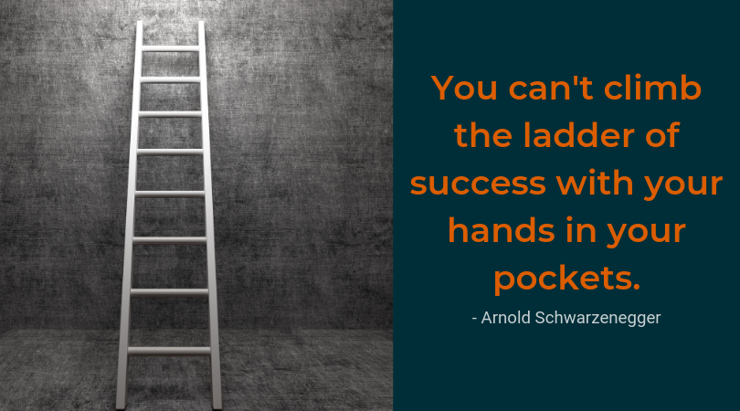

Slide 51
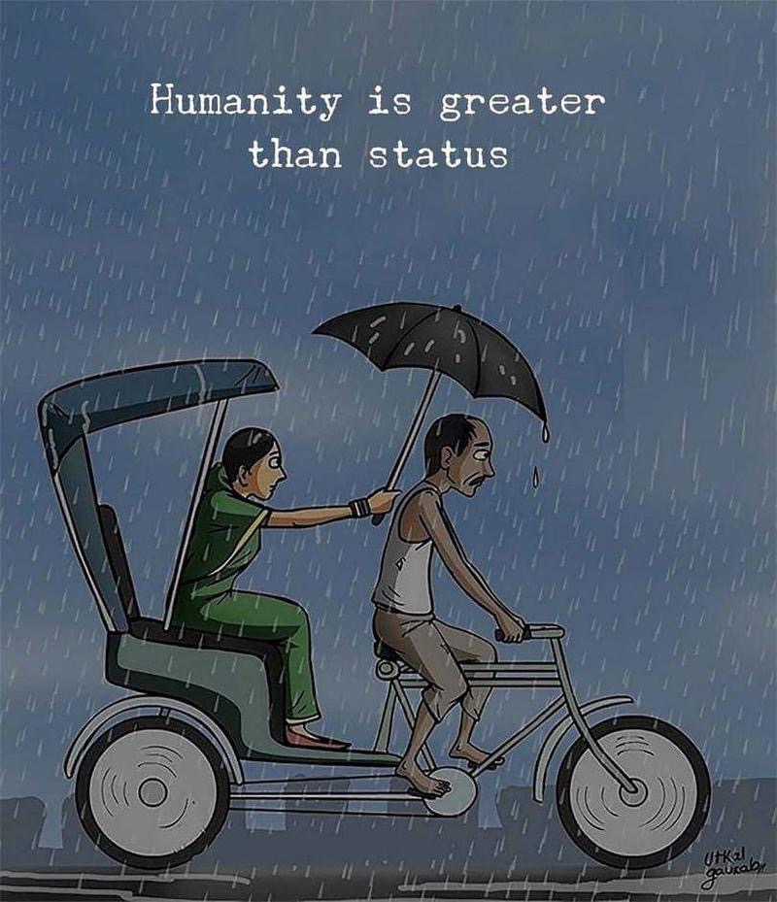
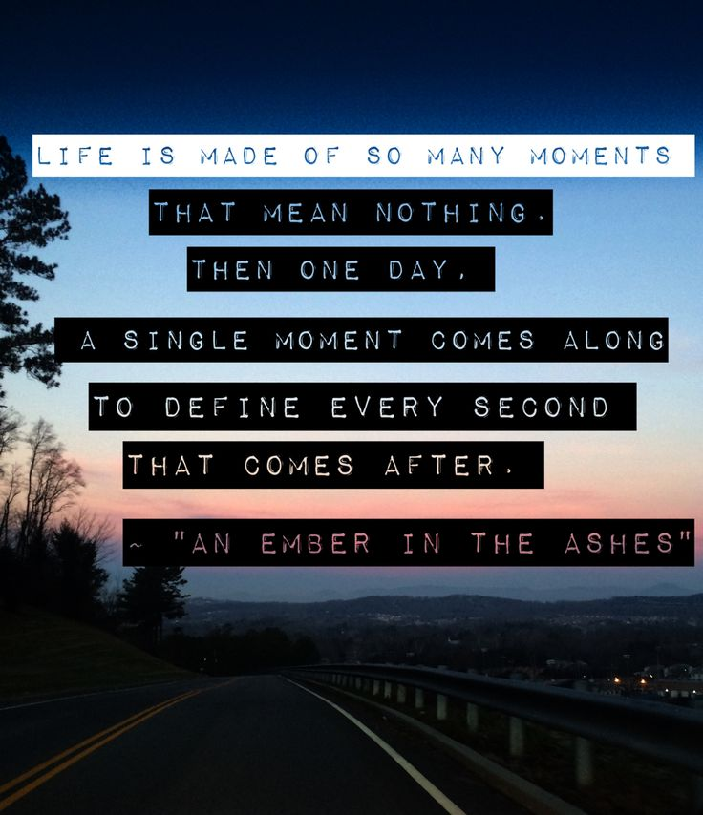

Slide 52

How can you have you upgraded your world.

Slide 53
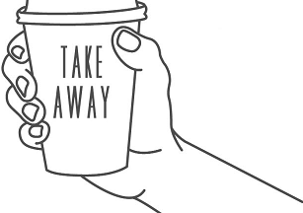
#UpgradeYourWorld Takeaways
Public Interest Technology is a field with increasing importance and relevance
Your world starts with you
Mentoring and coaching are 2 ways to be involved in upgrading yourself, your team and your organisation
Technology Proficios are those organisations who operationalise the upgrade of other’s worlds and in the process, upgrade their own worlds.
Upgrading your world takes innovation, collaboration and works best in co-designed solutions
You can rarely upgrade anything yourself. You need mass. Social Impact takes a Planet – Khanjan Mehta
Finding your Big Friendly Giant (BFG) is a great way to start on the path.
Go.Do.Change

Slide 54
Have we met our objectives
Understood the concept of Public Interest Technology
Understood the genesis of the UpgradeYourWorld hashtag
THOUGHT & REFLECTED upon implied obligations as a current/future ICT Professional
Become aware of Technology Proficios
Identified areas for further exploration in your own time
Become more knowledgeable at the end of the session than when arriving

Slide 55


